Slide 1
The RSA Cryptosystem
and Factoring Integers
Lecture 12
Vahid Amin-Ghafari
Vahidaming@cumt.edu.cn

Slide 2
OUTLINE
[1] Modular Arithmetic Algorithms
[2] The RSA Cryptosystem
[3] Quadratic Residues
[4] Primality Testing
[5] Square Roots Modulo n
[6] Factoring
[7] The Rabin Cryptosystem

Slide 3
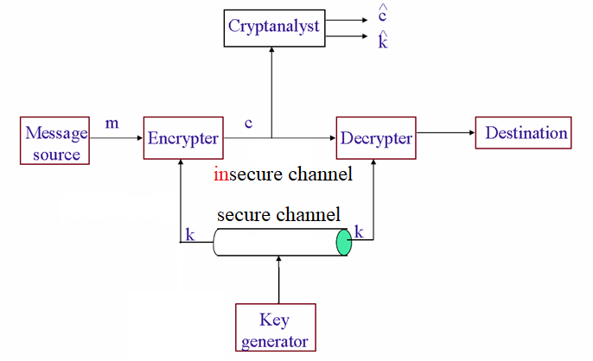
Private Key Encryption (review)

Slide 4
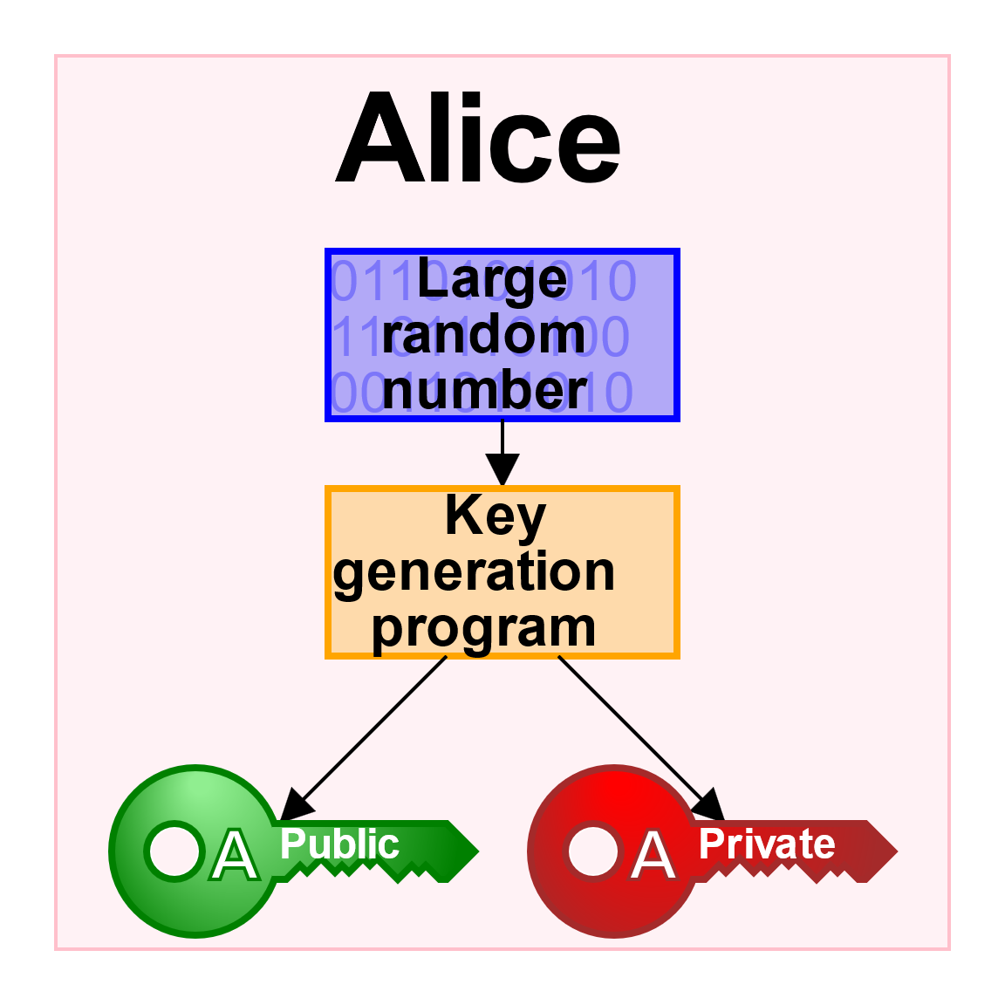
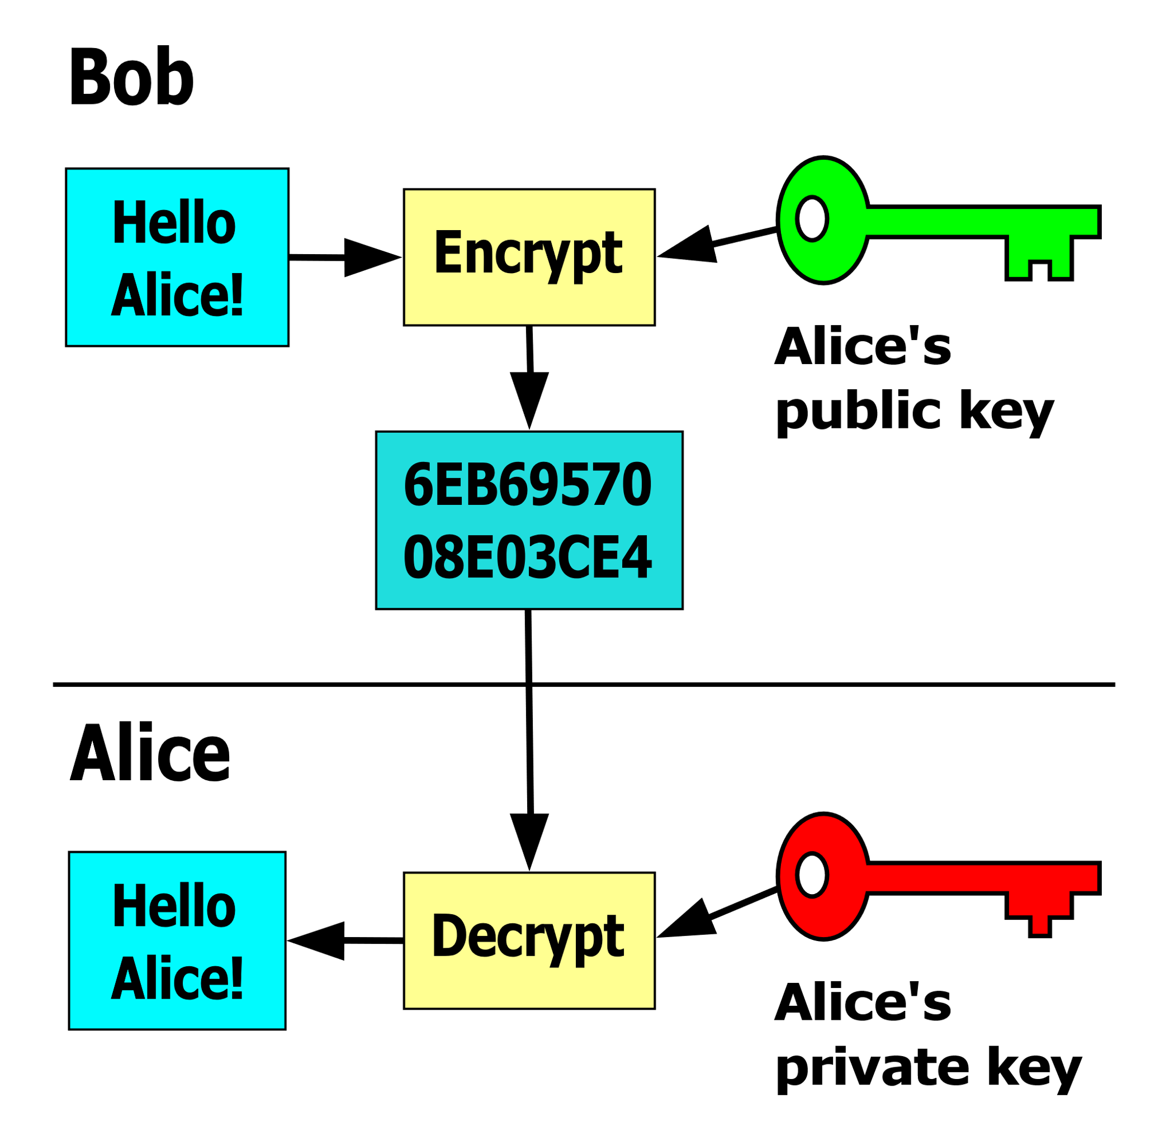
Public-key cryptography

Slide 5
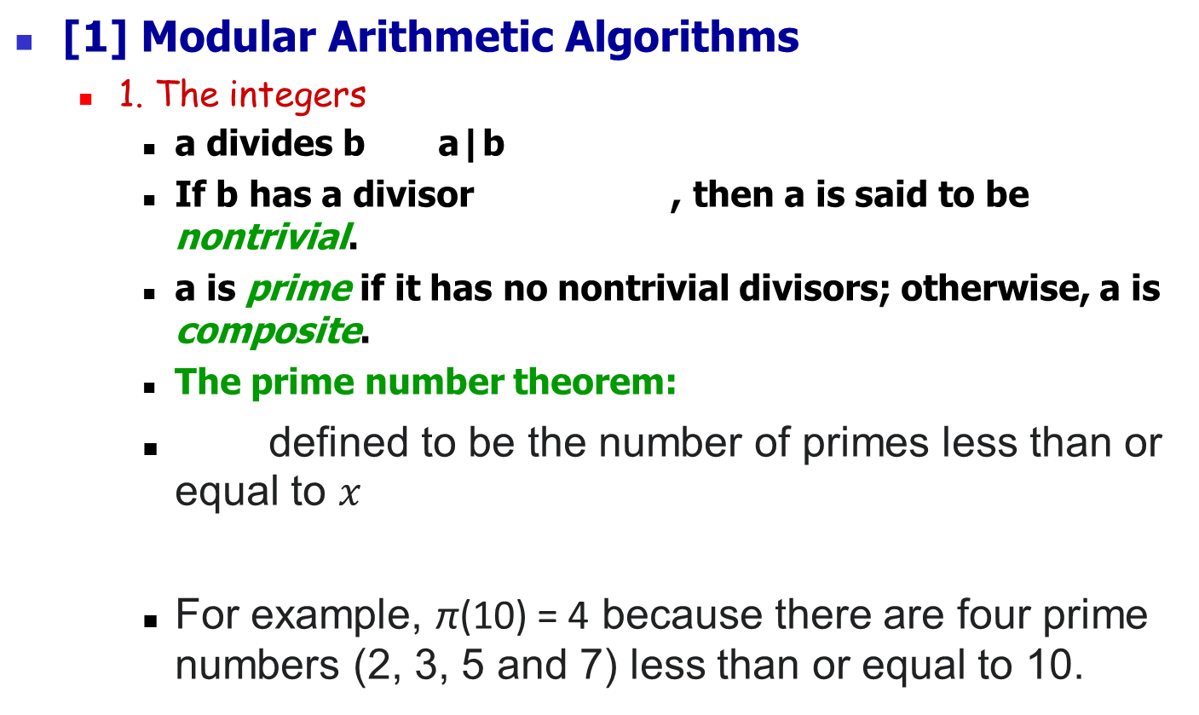
[1] Modular Arithmetic Algorithms
1. The integers
a divides b a|b
If b has a divisor , then a is said to be nontrivial.
a is prime if it has no nontrivial divisors; otherwise, a is composite.
The prime number theorem:
defined to be the number of primes less than or equal to $x$
For example, π(10) = 4 because there are four prime numbers (2, 3, 5 and 7) less than or equal to 10.

Slide 6
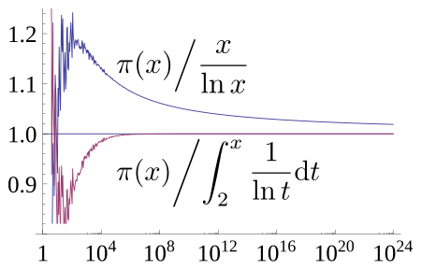
If c|a and c|b, then c is common divisor of a and b.
If d is a great common divisor of a and b, then we write d=gcd(a,b).
Notes:
Graph showing ratio of the prime-counting function π(x) to two of its approximations, x / log x and Li(x). As x increases (note x axis is logarithmic), both ratios tend towards 1. The ratio for x / log x converges from above very slowly, while the ratio for Li(x) converges more quickly from below.

Slide 7
Euclidean algorithm(a,b)
(for great common divisor)
input：
output：
(1) Set r₀=a and r₁=b
(2) Determine the first so that r_{n+1}=0,
where r_{i+1}=r_{i-1} mod r_{i}
(3) Return (r_{n})
Extended Euclidean algorithm(a,b)
input：a>0, b>0
output: (r, s, t) with r=gcd(a,b) and sa+tb=r
(Omitted)

Slide 8
Example ：gcd(299,221)=?

Slide 9
Euler phi-function
If gcd(a,b)=1, then a and b are said to be
relatively prime.
Phi function：
For example, the totatives of n = 9 are the six numbers 1, 2, 4, 5, 7 and 8. They are all relatively prime to 9, but the other three numbers in this range, 3, 6, and 9 are not, since gcd(9, 3) = gcd(9, 6) = 3 and gcd(9, 9) = 9. Therefore, φ(9) = 6. As another example, φ(1) = 1 since for n = 1 the only integer in the range from 1 to n is 1 itself, and gcd(1, 1) = 1.
Notes:
letter phi

Slide 10
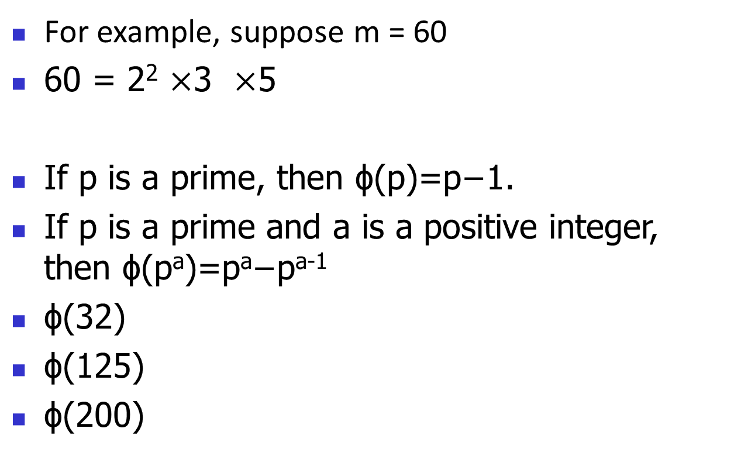
For example, suppose m = 60
60 = 2² $×$3 $×$5
If p is a prime, then ϕ(p)=p−1.
If p is a prime and a is a positive integer, then ϕ(pª)=pª−p^{a-1}
ϕ(32)
ϕ(125)
ϕ(200)
Notes:
ϕ(32)=32−16=16ϕ(32)=32−16=16, ϕ(125)=125−25=100, ϕ(200)=ϕ(25)ϕ(8)=(25−5)(8−4)=80

Slide 11
2. The integers modulo n
a is congruent to b modulo n, written ,
if n|a-b.
Z_{n}={0,1,…,n-1}
Given , if , then a is
said to be invertible and its inverse x is denoted a⁻¹.

Slide 12
Use Extended Euclidean Algo to calculate a⁻¹ mod n
Example：a=7 and n=9
Euclidean algorithm
to find gcd(a,n)
Extended Euclidean algorithm
to write gcd(a,b)=sa+tn

Slide 13
Z_{n}*={a|gcd(a,n)=1 and 0<a<n}
For example, Z₁₂*={1,5,7,11},
Z₁₅*={1,2,4,7,8,11,13,14}
(Z_{n}*, *) forms a multiplication group

Slide 14
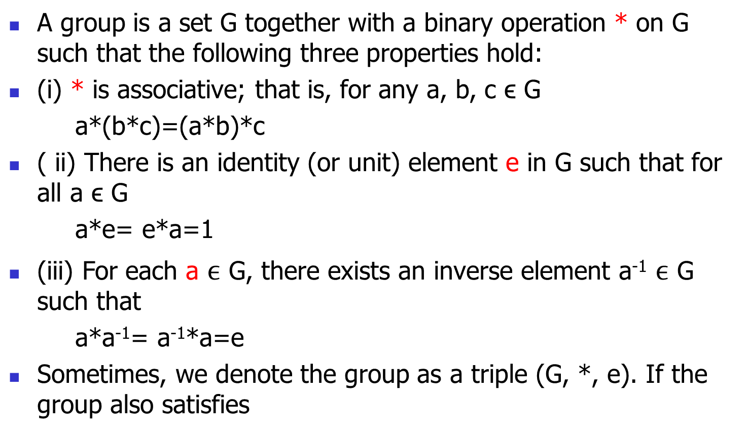
A group is a set G together with a binary operation * on G such that the following three properties hold:
(i) * is associative; that is, for any a, b, c ϵ G
a*(b*c)=(a*b)*c
( ii) There is an identity (or unit) element e in G such that for all a ϵ G
a*e= e*a=1
(iii) For each a $ϵ$ G, there exists an inverse element a⁻¹ $ϵ$ G such that
a*a⁻¹= a⁻¹*a=e
Sometimes, we denote the group as a triple (G, *, e). If the group also satisfies

Slide 15
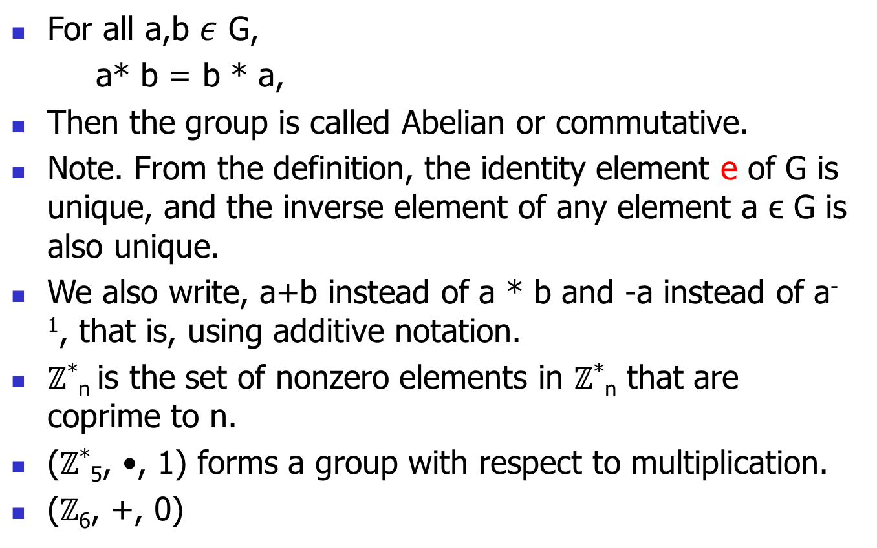
For all a,b $ε$ G,
a* b = b * a,
Then the group is called Abelian or commutative.
Note. From the definition, the identity element e of G is unique, and the inverse element of any element a ϵ G is also unique.
We also write, a+b instead of a * b and -a instead of a⁻¹, that is, using additive notation.
$ℤ$*_{n} is the set of nonzero elements in $ℤ$*_{n} that are coprime to n.
($ℤ$*₅, •, 1) forms a group with respect to multiplication.
($ℤ$₆, +, 0)

Slide 16
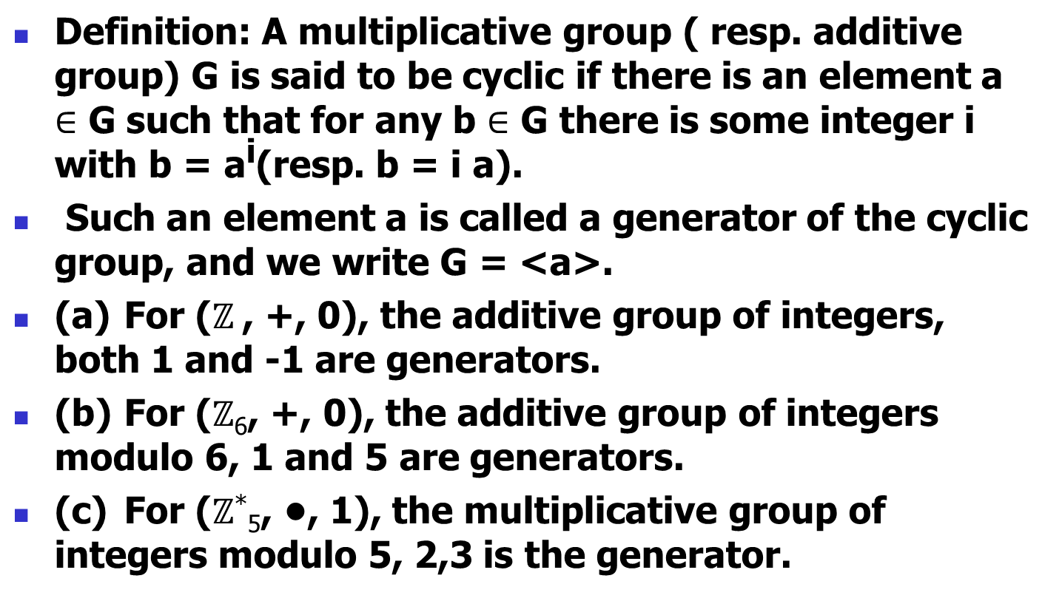
Definition: A multiplicative group ( resp. additive group) G is said to be cyclic if there is an element a $∈$ G such that for any b $∈$ G there is some integer i with b = a^{i}(resp. b = i a).
Such an element a is called a generator of the cyclic group, and we write G = <a>.
(a) For ($ℤ$ , +, 0), the additive group of integers, both 1 and -1 are generators.
(b) For ($ℤ$₆, +, 0), the additive group of integers modulo 6, 1 and 5 are generators.
(c) For ($ℤ$*₅, •, 1), the multiplicative group of integers modulo 5, 2,3 is the generator.

Slide 17
Fermat’s little theorem：
Euler’s theorem：
The order of , written ord(a), as the least positive integer t such that
If , has , then a is said to be a generator of Z_{n}*; in this case,

Slide 18
Example ：n=15
Z₁₅*={1,2,4,7,8,11,13,14}
ψ(15)= ψ(3) ψ(5)=2*4=8
1
2
4
7
8
11
13
14
1
4
2
4
2
2
4
2

Slide 19
3. Chinese remainder theorem
If the integers n₁,…,n_{k} are pairwise relatively prime,
then the system of congruences
has a unique solution modulo n=n₁*n₂*…*n _{k}

Slide 20
Algorithm：Gauss algorithm
(1) Input k , n_{i} , a_{i} , for i=1,2,…,k
(2) Compute for i=1,2,…,k
(3) Compute inverse for i =1,2,…,k
(4) Compute

Slide 21
Example

Slide 22
4. Square-and-Multiply
Algorithm: Square-and-Multiply(x, c, n)
Input： , c with binary representation
Output：

Slide 23
i | c_{i} | z
11 | 1 | 1²x9726=9726
10 | 1 | 9726²x9726=2659
9 | 0 | 2659²=5634
8 | 1 | 5634²x9726=9167
7 | 1 | 9167²x9726=4958
6 | 1 | 4958²x9726=7783
5 | 0 | 7783²=6298
4 | 0 | 6298²=4629
3 | 1 | 4629²x9726=10185
2 | 1 | 10185²x9726=105
1 | 0 | 105²=11025
0 | 1 | 11025²x9726=5761
Example :
9726³⁵³³ mode 11413=?

Slide 24
[2] The RSA Cryptosystem
Proposed by Rivest, Shamir, and Adleman (1977)
Used for encryption and signature schemes
Based on the intractability of the integer factorization problem
Key generation
Let p, q be large prime, n=pq and Φ=(p-1)(q-1)
Choose randomly e s.t. gcd(e,Φ)=1
Compute d ≡ e⁻¹ mod Φ
Public-key: (e, n)
Private-key: (d,n)
RSA function: f(m)=m^{e} mod n

Slide 25
Eg. p=7, q=13, n=91, Φ=72
Choose e=5, compute d=e⁻¹=29
Public-key: (5, 91)
Private-key: (29, 91)
Assume message m=23
So cipher-text c = m^{e} mod n = 23⁵ mod 91 = 4
and can be decrypted by
m = c^{d} mod n = 4²⁹ mod 91 = 23

Slide 26
n = pq
d*e = 1 (mod ø(n))
RSA encryption
Private key
KRa = (d, n)
KU_{a}
KR_{a}
Public key
KUa = (e, n)
M
C
M
E
D
E_{KUa}(M)=
Me (mod n)
D_{KRa}(C)=
C^{d} (mod n)
Encryption
Decryption

Slide 27
n = pq
d*e = 1 (mod ø(n))
RSA signature scheme
Signing key
KRa = (d, n)
Verification key
KUa = (e, n)
M
M
H
KR_{a}
KU_{a}
Compare
A
H
E
D
E_{KRa}(H(M))=
H(M)^{d} (mod n)
D_{KUa}(A)=
A^{e} (mod n)
Signing
Verification

Slide 28
[3] Quadratic Residue
1. Quadratic residue modulo n
Let , then a is a quadratic residue modulo n
if there exists with In this case,
x is a square root of a modulo n. Otherwise, a is a
quadratic nonresidue modulo n.
Q_{n}：the set of quadratic residues modulo n.
：the set of quadratic nonresidues modulo n.

Slide 29
2. Theorem ：p > 2 is prime and α is a generator of Z_{p}*

Slide 30
3. Corollary ： p > 2 is prime and α is a generator of Z_{p}*
(1)
(2)
(3)
(4)
4. Legendre symbol ：p > 2 is prime and

Slide 31
5. Theorem ：Euler’s criterion
6. E.g ：
use Square-and-Multiply

Slide 32
7. Jacobi symbol ：
n > 2 is an odd integer, p_{i} is prime and

Slide 33
8. Properties of Jacobi symbol：m, n > 2 are odd integers
(1)
(2)
(3)
(4)
(5)
(6)

Slide 34
9. E.g ：calculate Jacobi symbol without factoring n
(property 2)
(property 6)
(property 3)
(property 4)

Slide 35
10. Jacobi symbol V.S. Quadratic residue modulo n
The element of are called psedosquares modulo n.

Slide 36
11. E.g ：n=15
The Jacobi symbol are calculated in the following table：
1
2
4
7
8
11
13
14
1
-1
1
1
-1
-1
1
-1
1
-1
1
-1
-1
1
-1
1
1
1
1
-1
1
-1
-1
-1

Slide 37
12. Quadratic residuosity problem(QRP)
Determine if a given is a quadratic residue or
pseudosquare modulo n

Slide 38
[4] Primality testing
1. Trial method for testing n is prime or composite
2. Definition ：Euler witness
Let n be an odd composite integer and .
If
then a is an Euler witness for n.

Slide 39
3. Theorem
Let n be an odd composite integer and let be an
Euler witness for n. Then at least half of all elements
in Z_{n}* are Euler witnesses for n.
4. Theorem
Let n be an odd composite integer. Then there exists an
Euler witness for n in Z_{n}*.

Slide 40
5. Algorithm ：Solovay-Strassen
input： an odd integer n and security parameter t
output：an answer of “composite” or “probably prime”
(1) Do the following t times：
1.1 Select a random integer a, 1<a<n.
1.2 If , then return(“composite”).
1.3 If , then return (“composite”).
(2) return(“probably prime”).

Slide 41
6. Certificate for composite n
A certificate is provided which allows efficient verification
that n is indeed composite.
For Solobay-Strassen, the certificate is an Euler witness for n.
The probability that the test outputs “probably prime” when n is composite is at most 2^{-t}.
7. Miller-Rabin probabilistic primality test (Omitted)

Slide 42
[5] Square Roots Modulo n
1. Fact
Suppose that p is an odd prime and gcd(a,n)=1.
Then the congruence y²=a (mod n) has no solutions
if (a/p)=-1, and two solutions (mod n) if (a/p)=1.
2. Theorem
Suppose that p is an odd prime, e is a positive integer,
and gcd(a,p)=1. Then the congruence y²=a (mod p^{e})
has solutions if (a/p)=-1, and two solutions (mod p^{e})
if (a/p)=1.

Slide 43
3. Theorem
Suppose that n>1 is an odd integer having factorization
where the pi’s are distinct primes and the ei’s are positive
integers, Suppose further that gcd(a,n)=1.
Then the congruence y²=a (mod n) has 2^{l} solutions
modulo n if (a/p_{i})=1 for all i in {1, …, l}, and no solutions,
otherwise.

Slide 44
[6] Factoring
1. Pollard’s p-1 method
input： an integer n , and a prespecified “bound” B
output：factors of n

Slide 45
Why?
Suppose p is a prime divisor of n, and suppose that
q <= B for every prime power q|(p-1). Then
(p-1)|B!
At the end of for loop, we have
a=2^{B!} mod n
Now
2^{p-1}=1 mod p (by Fermat’s little Thm)
Since (p-1)|B!, it follows
a=2^{B!} =1 mod p
and hence p|(a-1). Since we also have p|n,
d=gcd(a-1, n) will be a non-trivial divisor of n
(unless a=1).

Slide 46
E.g. n=15770708441, B=180
a = 2^{180!} = 11620221425
D = gcd(a-1, n) = 135979
In fact, the complete factorization of n into primes is
15770708441 = 135979 x 115979
The factorization succeeds because 135978 has only
“small” prime factors:
135978 = 2 x 3 x 131 x 173

Slide 47
2. Pollard’s rho method
input： an integer n
output：factors of n
(1) Selecting a “random” function f with integer coefficients , and any
Begin with x=x₀ and y=y₀.
(2) Repeat the two calculations
until d=gcd(x-y,n)>1.
(3) Do the following compare
3.1 If d<n, we have succeeded.
3.2 If d=n, the method is failed. Goto (1).
(*) A typical choice of f(x)=x²+1, with a seed x₀=2.

Slide 48
Complexity of rho method
We expect this method to use the function f at most
E.g：n=551, f(x)=x²+1 mod 511 and x₀=2.
5
26
1
26
449
1
126
240
19

Slide 49
3. Random squares to factor n = pq
The idea is to locate with if
gcd(x+y,n) is a nontrivial factor of n.
For example：n=15, x=2, y=7 (2²=7² mod 15) => gcd(2+7,15)=3 is a nontrivial factor of n.

Slide 50
4. p_{t}-smooth
A factor base B={p₁, p₂,…,p_{t}} consisting of the first t primes is selected. If b factors over B, b is said to be p_{t}-smooth.
For example：B={2,3,5}, b=2³*5⁶ is 5-smooth; b=2³*7⁶ is not 5-smooth.
We may include -1 in B to handle the negative b
B={p₀, p₁, p₂,…,p_{t}}, with p₀=-1.

Slide 51
5. The factor base factorization method
input： a composite integer n and factor base B= {p₁, p₂,…,p_{t}}
output：factors of n
(1) Suppose t+1 pairs (a_{i}, b_{i}=a_{i}² mod n) are obtained, where
b_{i} is p_{t}-smooth over B and the factorizations are given by
(2) A set S is to be selected so that has only even powers of primes appearing.
(3) Let , and do the following compare
3.1 If
3.2 If

Slide 52
E.g ：n=10057, t=5, B={2,3,5,7,11}
1
231
1018
2*509
1
105
968
2³*11²
2
115
3168
2⁵*3²*11
3
1006
6336
2⁶*3²*11
4
3010
8800
2⁵*5²*11
5
4014
882
2*3²*7²
6
4023
2816
2⁸*11
If S={4,5,6}, then x=3010*4014*4023 mod n=2748
y=2³*3*5*7*11 mod n=7042
Since , we obtain a nontrivial factor gcd(x+y,n)=89,
and 1057=89*113.
If S={1,5}, then x=105*4014 mod n=9133 and y=2²*3*7*11=924.
Unfortunately, , and no useful information is obtained.

Slide 53
6. The quadratic sieve factorization method
input： an composite integer n
output：factors of n
(1) choose a suitable P and construct a factor base
(2) Define
(3) Let a_{i}=z+m and b_{i}=q(z)=a_{i}²-n for z=0,1,-1,2,-2,…….. A set S is to be
selected so that has only even powers of primes appearing.
(4) Let , and do the following
3.1 If
3.2 If

Slide 54
9. E.g ：n=10057
0
100
-57
-3*19
-1
99
-256
-2⁸
1
101
144
2⁴*3²
-3
97
-648
-2³*3⁴
5
105
968
2³*11²
If S={1}, then x=101 and y= =2²*3.
Since , we obtain a nontrivial factor gcd(x+y,n)=113,
and 1057=89*113.
If S={-1,-3, 5}, then x=99*97*105 and y=2⁷*3²*11.
Unfortunately, , and no useful information is obtained.

Slide 55
[7] The Rabin Cryptosystem
1. Rabin scheme
Let p, q be large primes, n=pq
(p,q) be the private key
Encryption: c=m² mod n
Decryption: find the four square roots and one is m
2. Example
Consider p=31, q=41, so n=pq=1271
Assume message m=814
so c = m² mod n = 814² mod 1271 = 405
Decryption
Solving m² ≡ 405 ≡ 2 (mod 31) and m² ≡ 405 ≡ 36 (mod 41)
obtain m ≡ ±8 (mod 31) and m ≡ ±6 (mod 41)
four possible roots: {±240, ±457} (mod 1271)

Slide 56
3. How to find square roots of a ∈ Q_{n} where n=pq ?
Factor n as pq
Let x and y satisfy following congruences
x = a_{p} (mod p) and y = -a_{p} (mod p)
x = a_{q} (mod q) y = a_{q} (mod q)
where a_{r} denotes a square root of a modulo r
The square roots are x, -x, y, -y

Slide 57
4. How to find square roots of a ∈ Q_{p} ?
In general, there is an efficient polynomial randomized algo
For p=3 (mod 4) there is a deterministic algo:
By Euler’s criterion if a ∈Q_{p} then a^{(p-1)/2}=1 (mod p),
and (a^{(p+1)/4})² = a^{(p-1)/2}a= a (mod p).
Hence two roots of a modulo p are ±a^{(p+1)/4} .
n is called Blum integer if n = pq and p=3 (mod 4), q=3 (mod 4)

Slide 58
5. Definition
RABIN: Given n=pq and c=m² mod n, find x, s.t. c ≡ x² (mod n)
6. Theorem
RABIN = FACTOR
<pf>
(1) RABIN ≤ FACTOR
Given an oracle for FACTOR
1. Factor n and obtain p,q
2. Solve the square root problems (section 11.4)
c ≡ x² (mod p)
c ≡ x² (mod q)
3. Apply CRT and get four roots of RABIN

Slide 59
(2) FACTOR ≤ RABIN
Given an oracle for RABIN
1. Query RABIN oracle twice, get two roots x and y
2. With prob. ½, we can successfully get the factor of n by
gcd(x+y, n)

